Slide 1
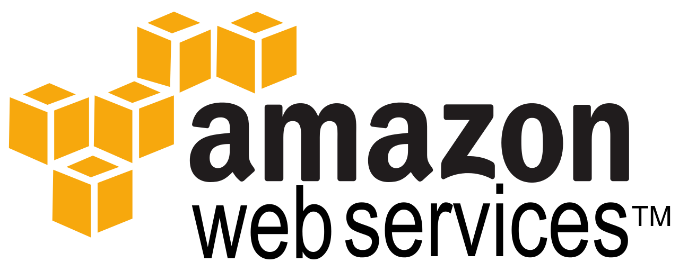
Hands on Training on
By:
Sandeep Rawat

Slide 2
About Me
Sandeep Rawat
Devops Architect and Evangelist
I am devops enthusiast.
I have led devops transformations in companies like snapdeal.com, mettl.com, beachbody.com.
To take the devops mission forward 2 years back I co-founded a devops company.

Slide 3

Introduce Yourself
About you
Your technical abilities in Devops
What's your expectation from the program

Slide 4

Hands on leanring
We will learn by doing it ourselves:
To simulate the learning conditions we will use a web app which will have 3 parts
A web server acting as a proxy for all the requests
Dynamic content served by an application server
MySQL as database
Notes:
Setup of a web app which will have 3 parts
Static content served by web server
Dynamic content served by an application server
MySQL as database

Slide 5
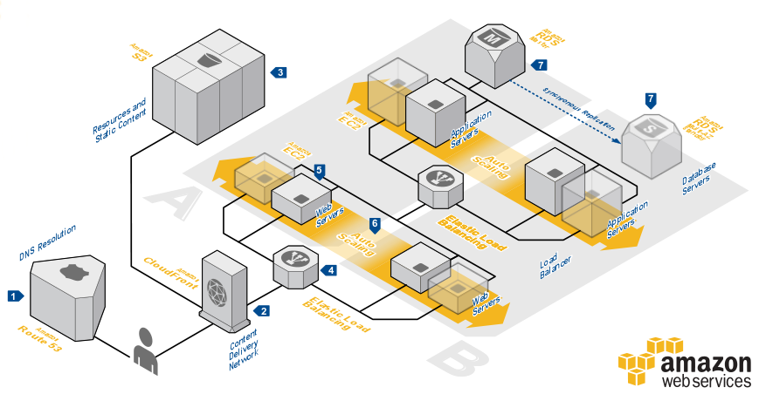
At the end of training
Notes:
Our target is to have a highly optimized scalable app, what does that mean
We will have CDN in place to serve the static content
The Application would be fault tolerant, it will be able to handle natural calamity as well
The infrastructure should be cost optimized, but should scale if your application is overnight success

Slide 6


Training Day 1
Learn
AWS Platform
Elastic Compute Cloud(EC2)
Elastic Block Storage (EBS)
Virtual Private Cloud
Practice (Hands On)
AWS Management Console
EC2 & EBS
Virtual Private Cloud

Slide 7

Schedule – Day 1
Time | Details
10:00 – 10:30 am | Introduction
10:30 – 11:00 am | Training methodology
11:00 – 11:30 am | Introduction to AWS & Management console
11:30 – 12:30 pm | EC2 & EBS presentation
12:30 – 12:45 pm | Break
12:45 – 2:00 pm | EC2 hands on
2:00 – 3:00 pm | Lunch
3:00 – 4:00 pm | VPC Presentation
4:00 – 5:00 pm | VPC demo from instructor
5:00 – 5:15 pm | Break
5:15 – 6:45 pm | VPC hands on for our application

Slide 8
Agenda – Session 1
Introduction to AWS
AWS Management Console
EBS Service
EC2 Service
Hands On

Slide 9
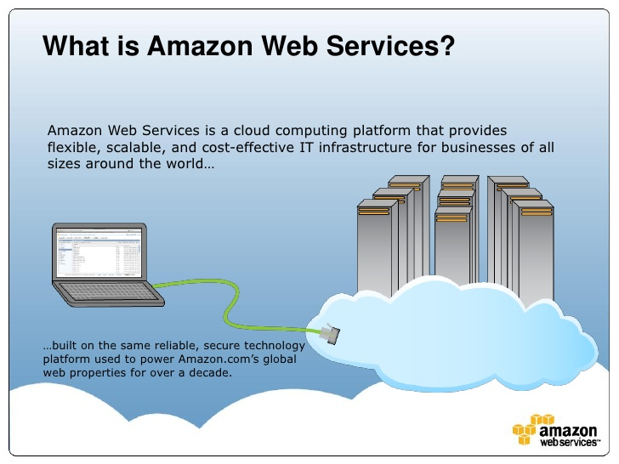

Slide 10
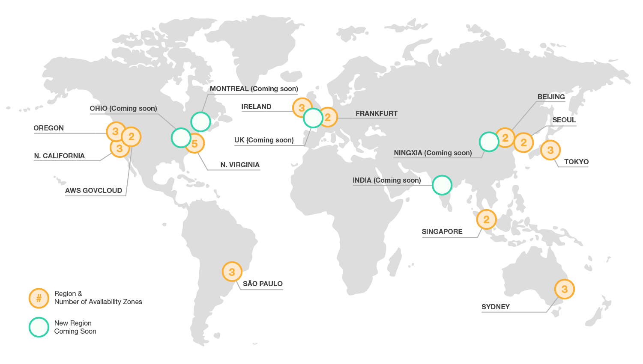
AWS – Global Presence

Slide 11
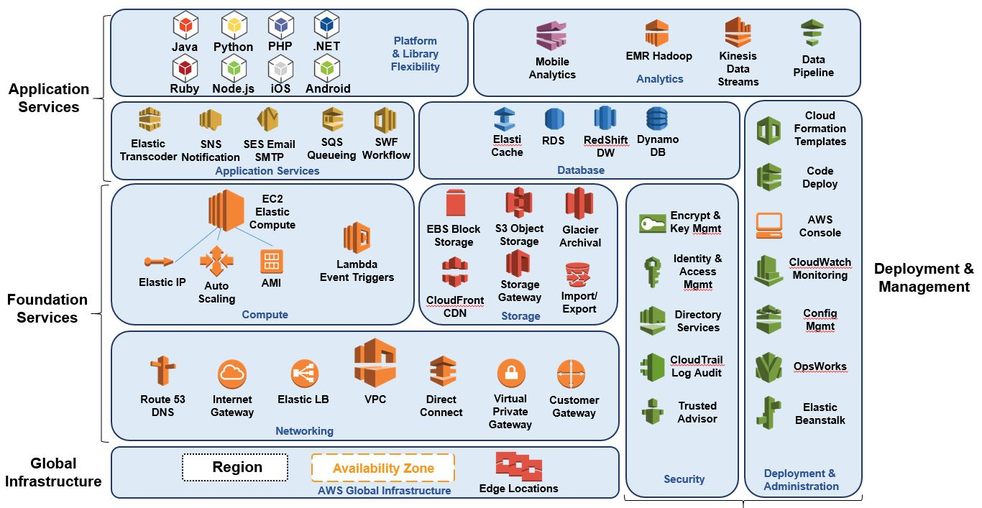
AWS Services

Slide 12
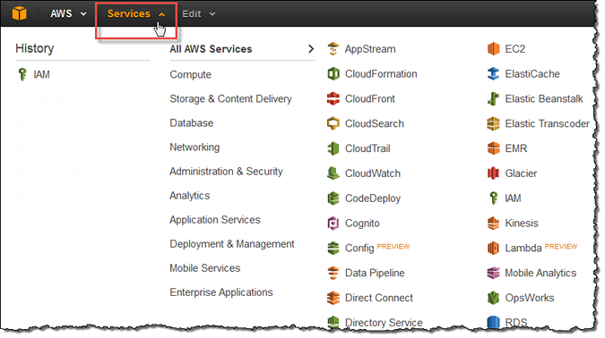
Management Console
Most important AWS interface

Slide 13
Dirty your hands
Walkthrough of Management Console
Notes:
Show the login screen
Show the management console
Show the edit feature where you can create shortcuts
Talk about basic groupings
- Compute
- Storage
- Networking
- Security
- Databases
- Application Services
- Analytics, quote about data pipeline project

Slide 14

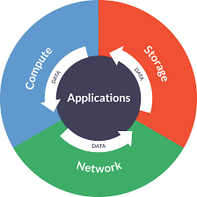
What makes a running system

Slide 15
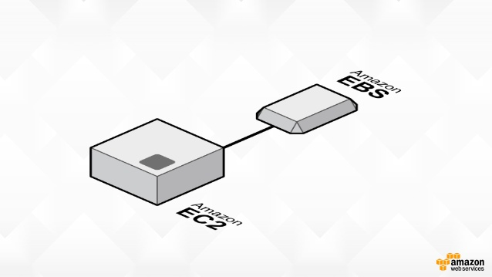

Slide 16
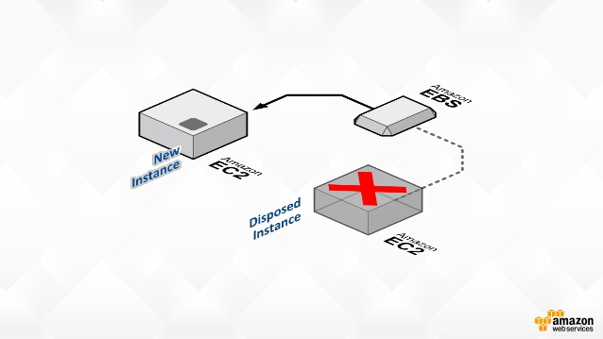

Slide 17
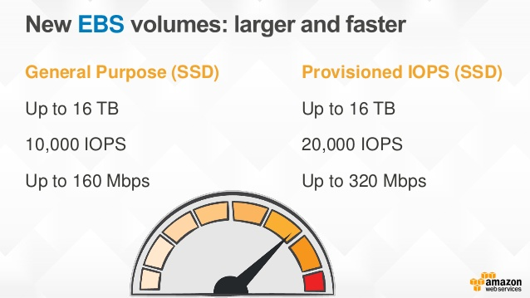

Slide 18
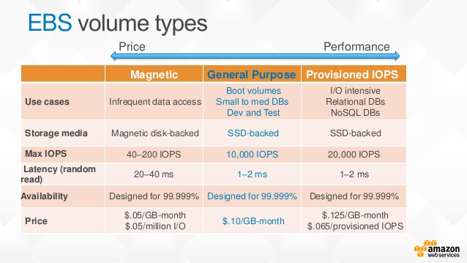
Notes:
IOPS: IOPS are input/output operations per second. Amazon EBS measures each I/O operation per second (that is 256 KiB or smaller) as one IOPS. I/O operations that are larger than 256 KiB are counted in 256 KiB capacity units. For example, a single 1,024 KiB I/O operation would count as 4 IOPS; however, 1,024 I/O operations at 1 KiB each would count as 1,024 IOPS

Slide 19
EC2 Creation
Step 1: Choose an Amazon Machine Image (AMI)
Step 2: Choose an Instance Type
Step 3: Configure Instance Details
Step 4: Add Storage
Step 5: Tag Instance
Step 6: Configure Security Group

Slide 20
EC2 – Choose an AMI
Step 1
An AMI is a template that contains the software configuration (operating system, application server, and applications) required to launch the instance. Here we select an AMI provided by AWS, user community, or the AWS Marketplace; or one of own AMIs.

Slide 21
EC2 – Choose an Instance Type
Step 2
Amazon EC2 provides a wide selection of instance types optimized to fit different use cases. Instances are virtual servers that can run applications. They have varying combinations of CPU, memory, storage, and networking capacity, and gives the flexibility to choose the appropriate mix of resources for the applications.

Slide 22
EC2 – Configure instance
Step 3
In this step configure the instance to suit the requirements. We can launch multiple instances from the same AMI, request Spot instances to take advantage of the lower pricing, assign an access management role to the instance, and more.

Slide 23
EC2 – Add Storage
Step 4
In this step instance will be launched with the seleteted storage device settings. We can attach additional EBS volumes and instance store volumes to the instance, or edit the settings of the root volume. We can also attach additional EBS volumes after launching an instance, but not instance store volumes.

Slide 24
EC2 – Tag Instance
Step 5
A tag consists of a case-sensitive key-value pair. For example, you could define a tag with key = Name and value = Webserver.

Slide 25
EC2 – Configure Security Group
Step 6
A security group is a set of firewall rules that control the traffic for the instance. On this page, we can add rules to allow specific traffic to reach the instance. For example, if we want to set up a web server and allow Internet traffic to reach the instance, add rules that allow unrestricted access to the HTTP and HTTPS ports. We can create a new security group or select from an existing one below.

Slide 26
Let's practice
Creation of EC2 Instance
Associating EBS
Apply some tags
Generate Key Pair
Notes:
In test vpc
Ubuntu Server 14.04 LTS (HVM), SSD Volume Type
wget https://raw.githubusercontent.com/OpsTree/AWSTraining/master/setup.sh

Slide 27
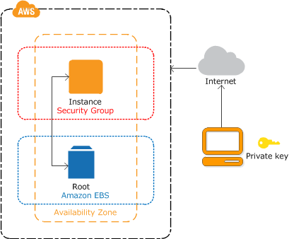
10K feet view
Notes:
Created an EC2 Instance with a compute capacity of t2.micro
Added an EBS root volume of capacity 20GB
Created a key pair to access this instance

Slide 28
What to choose
General Purpose (t2, m3 & m4) | Development environments, build servers, code repositories, low-traffic websites and web applications, micro services, early product experiments, small databases.
Compute Optimized ( c4 & c3) | High performance front-end fleets, web-servers, batch processing, distributed analytics, high performance science and engineering applications, ad serving, MMO gaming, and video-encoding.
Memory Optimized (r3) | Memory-optimized instances for high performance databases, distributed memory caches, in-memory analytics, genome assembly and analysis, larger deployments of SAP, Microsoft SharePoint, and other enterprise applications.
GPU (g2) | 3D application streaming, machine learning, video encoding, and other server-side graphics or GPU compute workloads.
Storage Optimized | NoSQL databases like Cassandra and MongoDB, scale out transactional databases, data warehousing, Hadoop, and cluster file systems.

Slide 29
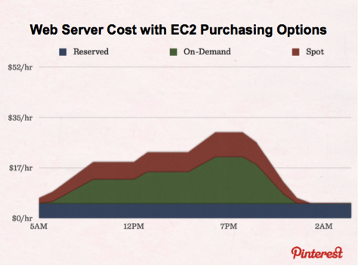
Saving is Important

Slide 30
Things to Remember
Security & Network | IAM Start with maximum security Regular patching
Storage | Selection of root device storage Separate volume for OS & data Use instance store for temporary data
Resource Management | Keep track of your instances Track of maintenance activities and your limits
Backup & Recovery | Automated Redundancy Monkey testing

Slide 31
What we learned
AWS Management Console
EBS Service
EC2 Service
A bit of puppet
Notes:
‹#›

